Slide 1
Asthma Management
Lisa Nave
Nursing
Platt College

Slide 2
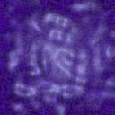
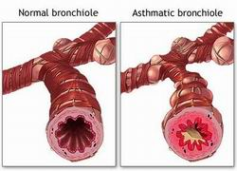
What is Asthma?
Asthma is a chronic inflammatory disease of the lungs characterized by narrowing of the airways in the lungs causing sudden and recurrent onset of symptoms including…
Difficulty breathing
Wheezing
Cough
Chest tightness
Decreased air movement
Loss of consciousness
Respiratory Arrest

Slide 3
What causes it?
An asthma attack may be caused by any number of triggers that should be avoided by patients
Dust mites
Animal dander
Cock roaches
Molds
Allergens(seasonal pollens & ragweed)
Some chemicals and perfumes
Smoke

Slide 4
How is it diagnosed?
Diagnosis can be made according to symptoms but using a peak flow meter will assist in diagnosis
Peak flow meter is also used to measure how in control of asthma patient is
Peak flow measures the amount of air patient is able to forcefully push out of lungs
Peak flow should be done regularly and recorded by patient daily
Changes in amount of peak flow indicate worsening lung function or start of episode, seek treatment

Slide 5
Medications
Daily medications may be given orally, by nebulizer or by metered dose inhaler to prevent symptoms.
Short acting medications(Albuterol,Xopenex) relax smooth muscles and is also known as rescue inhaler
Rescue inhaler begins to work within 5-10 min
When using inhaled steroid and short acting inhalers for management use short acting first wait 15 minutes then take steroid next. Using spacer.

Slide 6
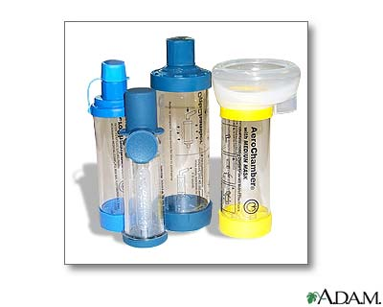
Medications
Spacers should be used with metered dose medications
Spacers ensure that the medications are better inhaled into the lungs instead of the back of the throat, which allows them to work better.
Rinse mouth out after
Inhaled medications
to prevent oral infections
and reduce irritation

Slide 7
Management Plan
Patients should keep an Written Asthma Management Plan including…
  Name
  Medication Allergies
  Medical Conditions
  Medications and how they are taken
  Asthma triggers
  Physician Name and number
  How to treat Asthma attacks
  Patient normal peak flow results

Slide 8

Should I Call my Doc?
  Physician is a key component in management of asthma. Call your physician when….
  Management medications are ineffective
  More than regular use of rescue inhalers
  Decreased in peak flow meter
  Management plan is ineffective
  Any signs of infection especially respiratory infection
  Regular well checks are an important part of an asthma management plan

Slide 9

How to prevent Attacks?
  It is possible to prevent attacks using management plan which a key part includes knowing triggers and decreasing exposure to those…
  Keep pets outside
  Bathe pets frequently if keeping in house
  Use bed protectors to prevent dust mites
  Dust regularly
  Keep away from smoke
  Prevent mold and mildew build up
  Prevent roach infestations

Slide 10

When to call for help!?!
  Asthma attacks can quickly become a medical EMERGENCY! Call 911 IMMEDIATELY if…
  Rescue medications are ineffective (within 5-10 minutes)
  Loss of consciousness
  Unable to breathe
  Head bobbing may be noticed
  Cyanosis
  Breathing may stop
  Completely, Start CPR and call
  For help immediately!

Slide 11
Family Support/Resources
  A number of support groups and references are available for patient and family members….
American Thoracic Society
  http://www.thoracic.org
The Centers for Disease Control and Prevention
  http://www.cdc.gov/asthma
National Asthma Education and Prevention Program
  http://www.nhlbi.nih.gov/about/naepp/
Asthma and Allergy Foundation of America
  http://www.aafa.org
American Lung Association
  http://www.lungusa.org
American Academy of Allergy, Asthma, and Immunology
  http://www.aaaai.org
Allergy and Asthma Network/Mothers of Asthmatics, Inc.
  http://www.aanma.org

Slide 12
QUESTIONS?
LISA NAVE
NURSING PLATT COLLEGE
lisanave03@gmail.com

