Slide 1
Student Evaluation of Teaching
Crystal Jensen

Slide 2
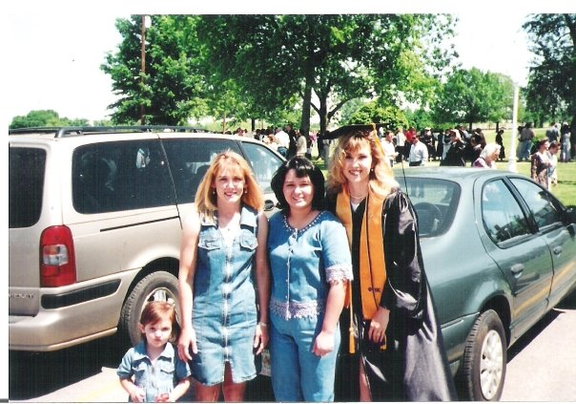
RSU graduation 1999

Slide 3
Example 1
From: Tina Jones [tinamariejones2003@yahoo.com]
Sent: Tuesday, March 13, 2012 7:27 PM
To: Crystal Jensen
Subject: Re: Tina Jones LOR
Thank you so much Mrs. Jensen. It means a great deal, and you giving it your immediate attention is so thoughtful of you. It's instructors and advisors as yourself that help turn a program into a success. I value your opinion and expertise. Please keep doing great things. You are part of the reason I remembered what kind of student I wanted to be when I met you in December. Thank you.

Slide 4
Example 2
From: Julie Salamy [mailto:juliesalamy@hotmail.com]
Sent: Wednesday, May 16, 2012 1:11 PM
To: Crystal Jensen
Subject: Re: Julie Salamy
I just wanted to make sure that you know how much I appreciated having you as a clinical instructor. There are people in the world that influence others in a positive way & help them strive to be a better person and you did that for me in clinicals... You expected nothing but the absolute best & made me want to be better. I still have a lot to learn but I feel like you and Jennifer were the perfect teachers for me at the end of my journey to get my ASN. You guys made me feel like (as my instructors), I can succeed. Now because of the positive influence you all have had on me in the short period of time that I have know you, I have the desire to go further with my education. Sometimes you never know when what you do may influence others & I just want to say thank you for being in the right place at the right time for me.. :-)

Slide 5
Example 3
From: Lisa Nave [mailto:lisanave03@gmail.com]
Sent: Wednesday, August 08, 2012 8:11 PM
To: Crystal Jensen
Subject: Clinicals
Mrs. Jensen,
Hi! I just wanted to let you know I had the most amazing day at clinicals! Kathy showed me all aspects of nursing from court room proceedings as a witness to addressing physical and psycho-social issues with patients. Plus we were going over a lot of evidence based practice studies we were actually working on today along with peer review issues. I've got to experience a little of every aspect of nursing that I never thought I would be interested in and have found I'm so excited about and want to participate in this study stuff and have even ended up volunteering to help her with anything I can to just be involved with this. I appreciate your consideration. And I still have a ton to tell you about my amazing day! I feel like a kid that just got back from Disneyland! LOL
Thank you,
Lisa Nave SN

Slide 6
Example 4
From: chiudoye@yahoo.com [chiudoye@yahoo.com]
Sent: Thursday, October 04, 2012 1:18 AM
To: Crystal Jensen
Subject: Re: Exam 1 Study Guide
Thank you so much for all you do, we really appreciate you. Thanks, Secunda Sent via BlackBerry from T-Mobile

Slide 7
Example 5
From: Lisa Nave <lisanave03@gmail.com>
Date: Mon, Sep 24, 2012 at 8:00 PM
Subject: home health paper
To: Crystal Jensen <cjensen@plattcollege.org>
Here is my paper on home health hospice. Thanks for all the help! You've been more help than you know with everything going on both personally and in class. I appreciate all the support. You're a wonderful instructor and have encouraged me most when I needed that little push to keep going.
Thank You!
Lisa Nave SN

Slide 8
